Slide 1
Chinese
Introduce by: Liu

Slide 2
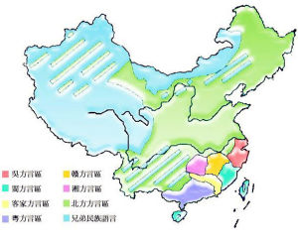
What’s Chinese
500 years already
7 main dialects
Han
90%

Slide 3
The position in the world
1.5 billion people use as mother language
11 main places where use the Chinese
6 places use for official language
one of the 6 UN official languages

Slide 4
The evolution of the forms of characters
Xiangxing
Zhish
Huiyi
Xingsheng
Zhuanzhu
Jiajie

Slide 5
Xiangxing
The earliest characters
Come from the pictograph
Huge limitation: it can’t describe the physical things and abstract things
Examples of Xiangxing characters
日sun 山mountain 人human

Slide 6

Zhishi
Represented by the abstract words or symbols
To add the ideogram on the basis of pictogram
Examples of Zhishi characters
上 up 下 down

Slide 7
Huiyi
It composes a new character by two or more single character and a new meaning of this character
It has the strongest word-making function
There are 1200 characters at least are Huyi

Slide 8
Xingsheng
Made on the basis of three methods we said before
Made by two sides
One side is called categories side
One side is called sounds side
The categories sides used from Xiangxing and Zhishi
The sounds sides used from Xiangxing, Zhishi and Huiyi

Slide 9
Zhuanzhu
It can’t make new characters
It makes the same word have the different pronunciations
It is a kind of dynamic characters

Slide 10
Jiajie
It has 2 effects
one positive and one negative
Firstly, it uses the old characters to record some new characters (Positive)
Secondly, it makes few words have a lot of different meanings (Negative)

Slide 11
Two different writings of Chinese
Nowadays, the Simplified is the official handwriting in China which we called Chinese
Traditional one is much harder, but it looks more beautiful
Simplified one is easier and more convenient
The traditional one is the truly inheritance of Chinese

Slide 12
Why traditional is the truly inheritance Chinese
The Traditional one has a longer history
It has been kept from ancient and has not changed until nowadays
The Simplified one were officially made in 1937 and started using as official writing since 1970 because of the revolution of Chinese philosophers

Slide 13
THANKS FOR WATCHING MY PRESETATION

